Slide 1
Video Game Sales Analysis
Dashboard Story
Group 4
-Cassandra Brown
-Brenden Mertz
-Jweta Patel
-Rafael Quintero
-Diana Villarreal

Slide 2
How the Dashboard Works
Visualization Tool Used:
Tableau
Connection:
Tableau will connect to our SQLite database
Database Columns:
Game
Platform (Console)
Year
Genre
North America
Europe
Japan
Other Countries

Slide 3
Interactive Element
Filter Button 1: Video Game Genre
The following genres will be listed in either a drop down list or selectable buttons which will filter the entire dashboard accordingly.
Action
Adventure
Battle Royal
Building/Construction
Misc
MMO (Massive Multiplayer Online)
Party
Racing
RPG (Role-Playing Game)
Sandbox
Shooter
Simulation
Sports
Strategy
Survival

Slide 4



Interactive Element Continued
Filter Button 2: Video Game Console Type
The following console types will be listed in either a drop down table or selectable buttons which will filter the entire dashboard accordingly.
Xbox One
PS4
PC

Slide 5
Genre - Sales Statistics
After selecting the Genre, several sales statistics will be available based on the genre selected.
Sales of Genre by Region in a Bar Graph
Sales of Genre by Console Type in a Bar Graph
Sales over time of Genre by Region in a Line Graph
Sales over time of Genre by Console Type in a Line Graph

Slide 6
Console - Sales Statistics
After selecting the Console Type, several sales statistics will be available based on the console selected.
Sales of Console Type by Region in a Bar Graph
Sales of Console Type by Genre in a Bar Graph
Sales over time of Console Type by Region in a Line Graph
Sales over time of Console Type by Genre in a Line Graph

Slide 7
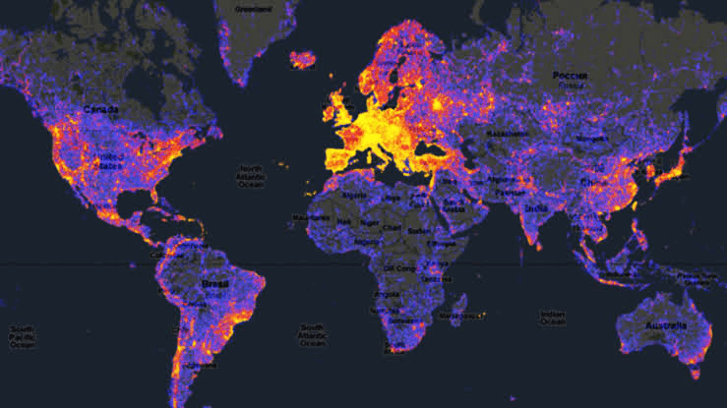
World Regional Heat Map
Video Game Sales by Genre/Console Type will be displayed on a World Continental Heat Map showing the four regions:
North America
Europe
Japan
Other

